Slide 1
Zoomanalysis
-Topic Modeling
By Preeti Amin, Kris Gallagher, Sunnie Wang

Slide 2
Purpose
To analyze text transcripts from meetings and extract a handful of main topics discussed during the meeting.

Slide 3
Use case
Can be used by researchers, students, and business professionals to provide an avenue of research into topic modeling trends.

Slide 4
Packages/Libraries Used
Panda
Numpy
Gensim
NLTK
Spacey
Os
Streamlit

Slide 5
Structure of our code
Transcripts preparations
Data Pre-processing
Training data - LDA.
Testing.
Notes:
Transcripts preparations - Data Pre-processing - Training data - LDA.
Testing.

Slide 6
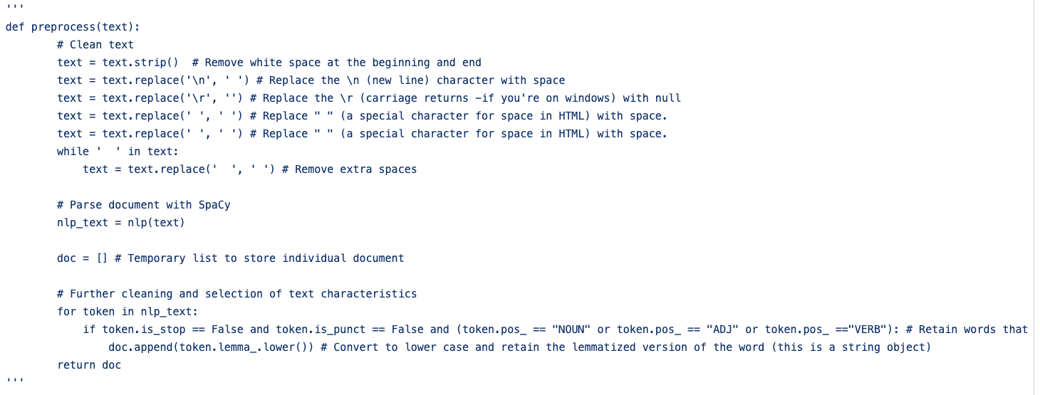
Data Pre-processing

Slide 7
Training data - LDA
# Form dictionary by mapping word IDs to words
ID2word = corpora.Dictionary(Documents)
# Set up Bag of Words and TFIDF
corpus = [ID2word.doc2bow(doc) for doc in Documents] # Apply Bag of Words to all documents in training corpus
TFIDF = models.TfidfModel(corpus) # Fit TF-IDF model
trans_TFIDF = TFIDF[corpus] # Apply TF-IDF model
### SET UP & TRAIN LDA MODEL ###
SEED = 75 # Set random seed
NUM_topics = 3 # Set number of topics
ALPHA = 0.9 # Set alpha
ETA = 0.35 # Set eta
# Train LDA model on the training corpus
lda_model = gensim.models.LdaModel(corpus=trans_TFIDF, num_topics=NUM_topics, id2word=ID2word, random_state=SEED, alpha=ALPHA, eta=ETA, passes=100)
## Save lda model, tfidf model and dictionary
lda_model.save('lda_model.model')
TFIDF.save('tfidf_model.model')
ID2word.save('corpora_dict')
Notes:
The transcripts were based on Latent Dirichlet allocation (LDA) is a topic model that generates topics based on word frequency from a set of documents.LDA is particularly useful for finding reasonably accurate mixtures of topics within a given documents.

Slide 8
Testing
We use Streamlit app to do prediction based on the trained models which are loaded into the app.
https://share.streamlit.io/preetiamin/courseproject/main/app.py

Slide 9
Thank you

